Slide 1
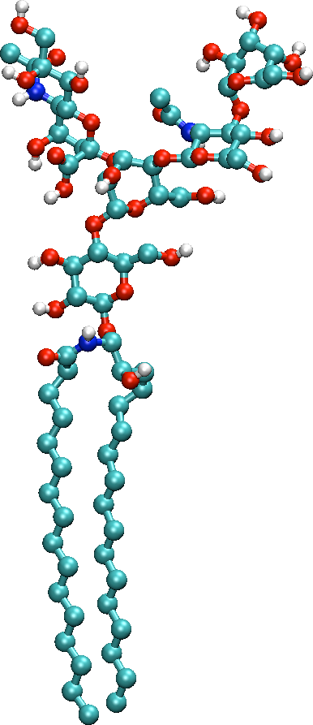
Computing Distance Histograms Efficiently in Scientific Databases
Yicheng Tu,§ Shaoping Chen,§¥ and Sagar Pandit§
§ University of South Florida, Tampa, Florida, USA
¥ Wuhan University of Technology, Wuhan, Hubei, China

Slide 2
Particle simulations
Major tool in computational sciences
Simulates a system of N entities behaving as classical particles
Atoms
Molecules
Stars
Galaxies
N is large (millions to billions)

Slide 3
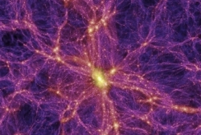
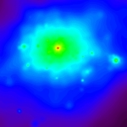
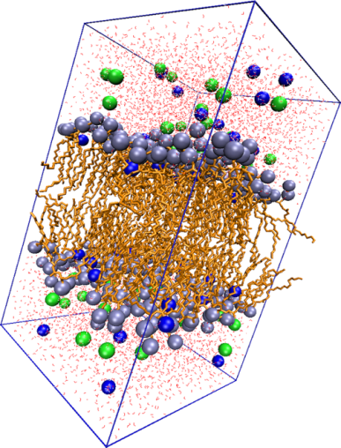
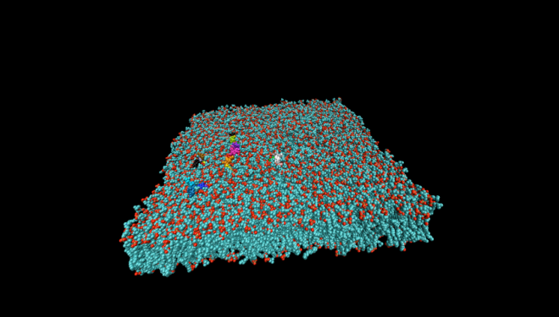
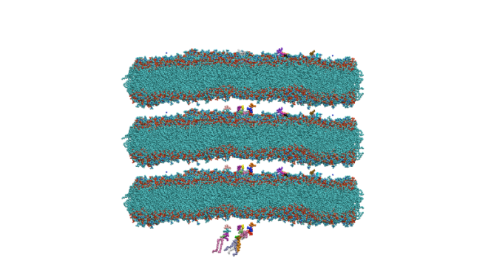
Particle Simulation in
Astronomy
Biology/chemistry – molecular simulation (MS)
Photo source: http://www.virgo.dur.ac.uk/new/images/structure_4.jpg

Slide 4
Querying MS data
Point query is not very helpful
Analytical queries are the main stream
Aggregates are not enough
Some require superlinear processing time
The m-body correlation functions - O(N^{m}) computations if done in a brute-force way
We study spatial distance histograms (SDH)
SDH is critical for analyzing key system states
SDH is a 2-body correlation - can we beat O(N²)?

Slide 5
Problem Statement
Given coordinates of N points, draw a histogram of all pairwise distances
Total distance counts will be N(N-1)/2
We focus on the standard SDH
Domain of distance [0, L_{max}]
Buckets are of the same width: [0,p), [p, 2p), …
Query has one single parameter:
bucket width p of the histogram, or
Total number of buckets l = L_{max}/p

Slide 6
Our approach
Main idea: avoid the calculation of pairwise distances
Observation:
two groups of points can be processed in one shot (constant time) if the range of all inter-group distances falls into a histogram bucket
We say these two groups are resolved into that bucket
20
15
Histogram[i] += 20*15;
10
bucket i

Slide 7
The DM-SDH Algorithm
Organize all data into a Quad-tree (2D data) or Oct-tree (3D data).
Cache the atoms counts of each tree node
Density map: all counts in one tree level
The algorithm :
start from one proper density map M₀
FOR every pair of nodes A and B in M₀
resolve A and B
IF A and B are not resolvable
THEN FOR each child node A’ of A
FOR each child node B’ of B
resolve A’ and B’

Slide 8
A Case Study
[0, 2√2]
[√10, √34]
Distance calculations needed for those irresolvable nodes on the leaf level !!

Slide 9
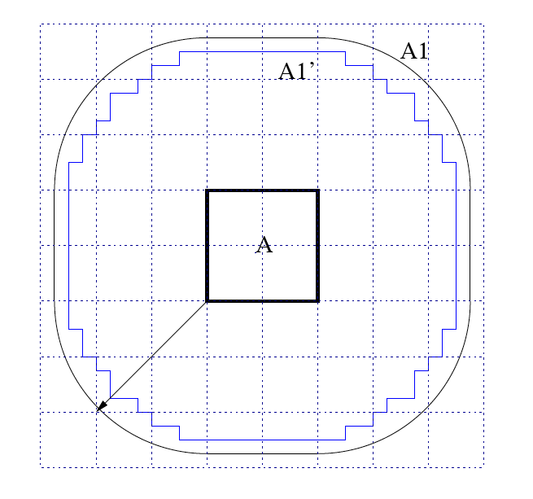
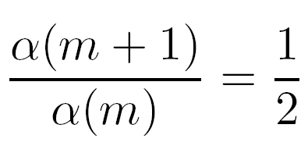
Is DM-SDH efficient (asymptotically)?
Quantitative analysis of DM-SDH
Based on a geometric modeling approach
The main result:
Notes:
α(m) is the percentage of pairs of nodes that are NOT resolvable on level m of the quad(oct)tree.
We managed to derive a closed-form for α(m)
α(m) decreases exponentially with more density maps visited

Slide 10
Easily, we have
Theorem 1: Let d be the dimension of data, then time spent on resolving nodes in DM-SDH is
Theorem 2: time spent on calculating distances of atoms in leaf nodes that are not resolvable is also

Slide 11
Therefore,
Theorem 3: time complexity of DM-SDH is
O(N^{1.5}) for 2D data
O(N^{1.667}) for 3D data
Theorem holds true for all reasonably distributed data (most scientific data fall into this category)

Slide 12
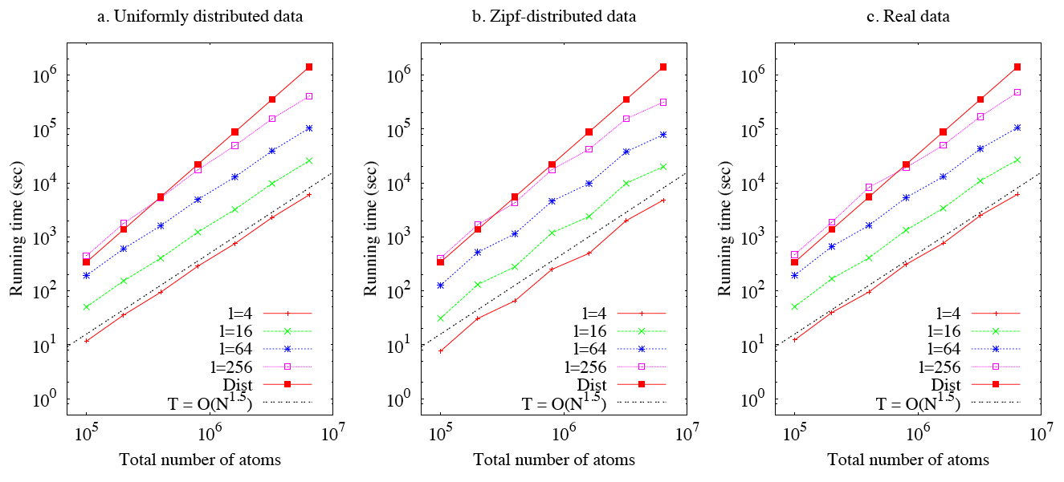
Experimental verification (2D data)

Slide 13
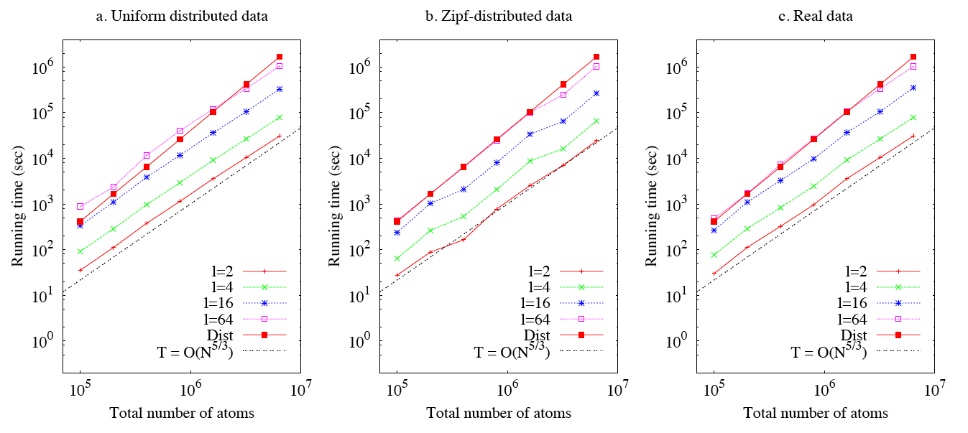
Experimental verification (3D data)

Slide 14
Faster algorithms
O(N^{1.667}) not good enough for large N?
Our solution: approximate algorithms based on our analytical model
Time: Stop before we reach the leaf nodes
Approximation: for irresolvable nodes, distribute the distance counts into the overlapping buckets heuristically
Correctness: consult the table we generate from the model

Slide 15
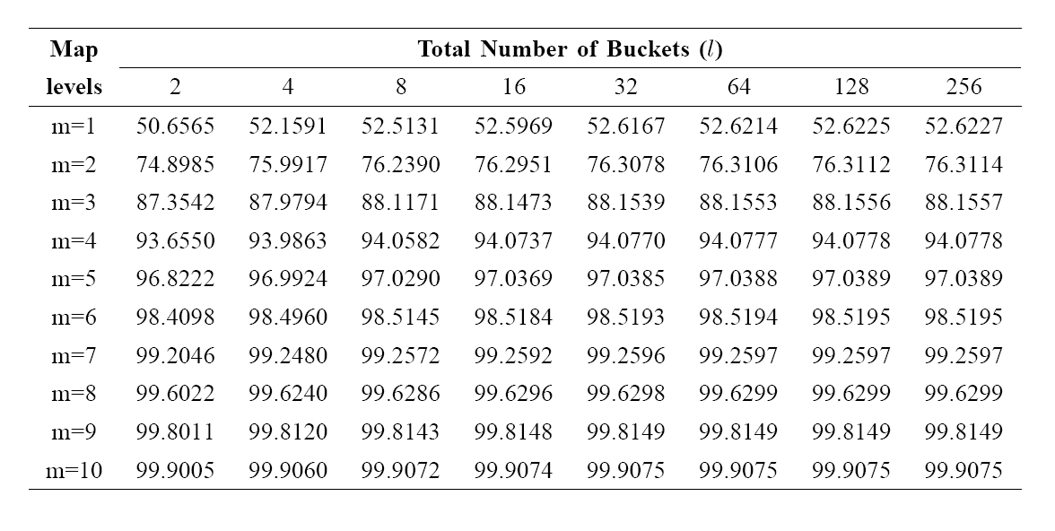
What our geometric model says …
Example: under l = 128, for a correctness guarantee of 97%, we have m=5, i.e., only need to visit 5 levels of the tree (starting from M₀)

Slide 16
How much time is needed?
Given an error bound Є, number of level to visit is
No time will be spent on distance calculation
Time to resolve nodes in the tree is
where I is the number of node pairs in M₀
The time is independent to system size N !

Slide 17
Irresolvable nodes
Not resolvable = range of distances overlaps with multiple buckets
Make a guess in distrusting the distance counts into these buckets
Several heuristics:
Left(right)most only
Even distribution
Proportional distribution
Distance range
bucket i bucket i+1 bucket i+2

Slide 18
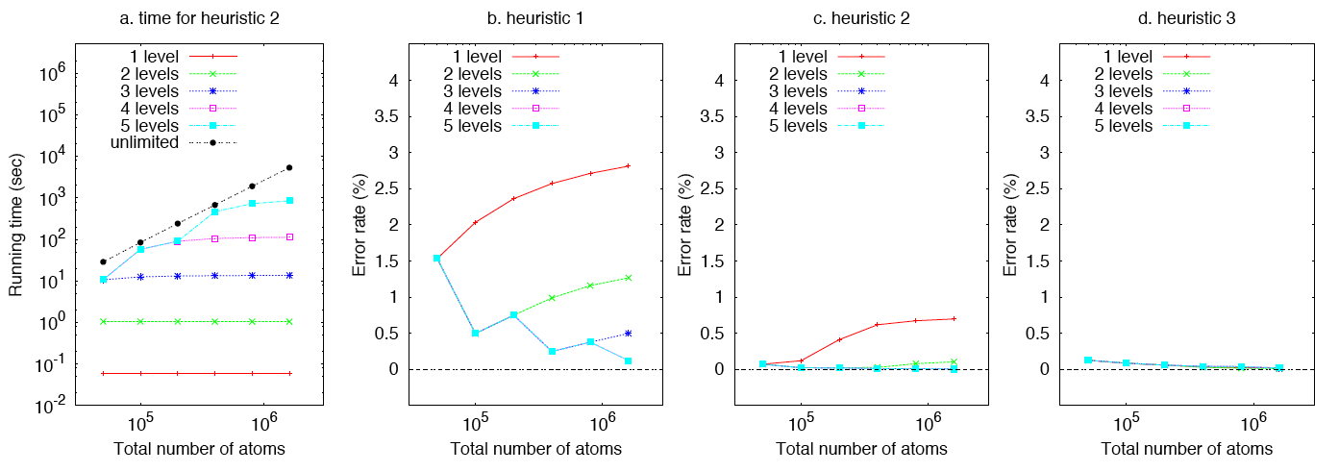
Experiments on approximate algorithms
where
h_{i}: count of bucket i in the correct histogram
h’_{i} : count of bucket i in the obtained histogram

Slide 19
What’s next?
The error bound given by consulting the table is loose
Our heuristics work well → much of the 1-Є distances will be placed into the right bucket
What’s the tight bound?
Continuous SDH query processing
SDH is often computed for a (large) number of consecutive frames
Save time by taking advantage of redundancy among neighboring frames

Slide 20
Summary
The distance histogram is an important query in simulation databases
We propose an algorithm based on a simple quad-tree-based data structure
Analysis of the algorithm shows it outperforms the brute-force approach
We develop an approximate algorithm with guaranteed error bound and very low time complexity
Further investigations on the approximate algorithm may yield a more practical fast solution

